Slide 1
Advanced Topics in Clinical Prediction Modelling
Dr Glen Martin/ Prof Niels Peek

Slide 2
Outline
We will here aim to cover some advanced topics to clinical prediction modelling, which are emerging in the literature and are being researched in our team
We will cover four themes of work:
The use, aggregation and updating of existing prediction models
Learning Health Systems approach to clinical prediction
Longitudinal models & challenges with informative observation
Causal Prediction Modelling

Slide 3
The use, aggregation and updating of existing prediction models
Learning Health Systems approach to clinical prediction
Longitudinal models & challenges with informative observation
Causal Prediction Modelling

Slide 4
Despite their many uses, the current workflow of CPM development is inefficient
Model Required
Develop & validate a prediction model
Reject the existing model(s)
Transfer the model through time/ space
Validate the model in the new population

Slide 5
An Alternative View: utilise existing models alongside new data
Existing model(s)
Develop a prediction model
Transfer of the model through time and/or space
Patient level data

Slide 6
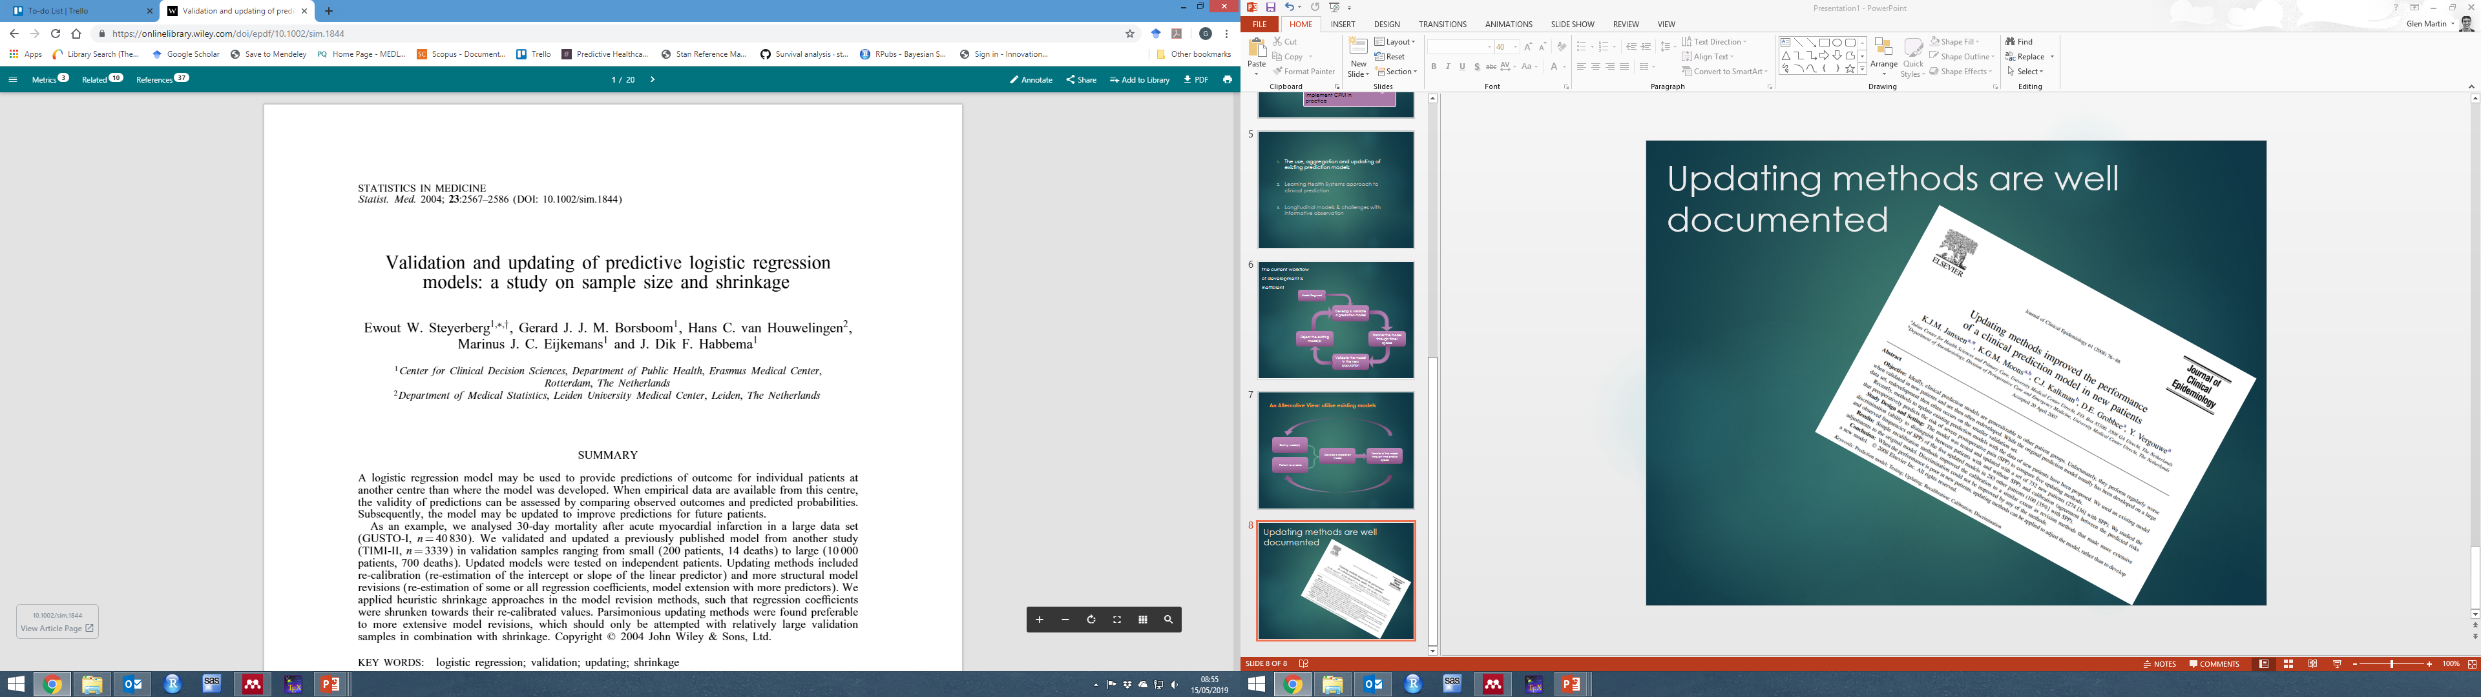
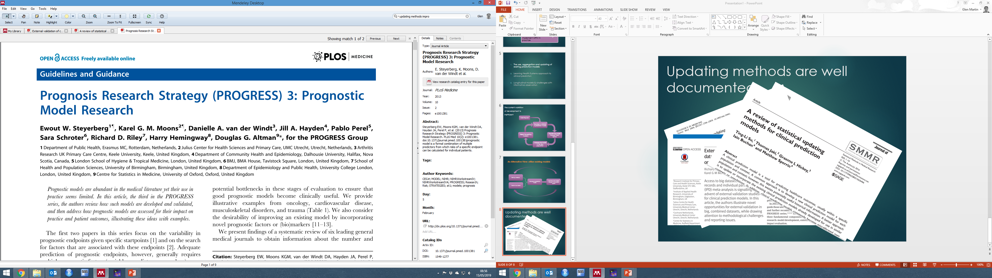
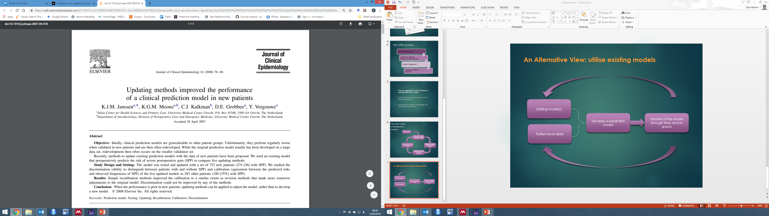
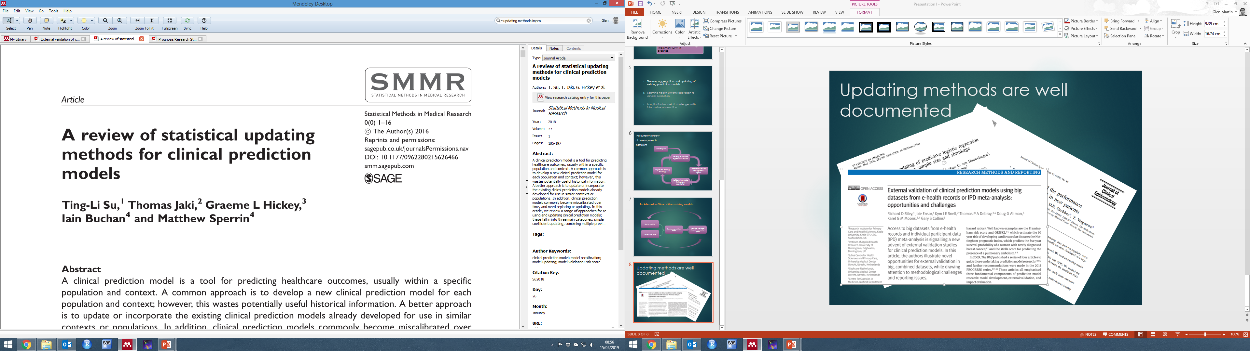
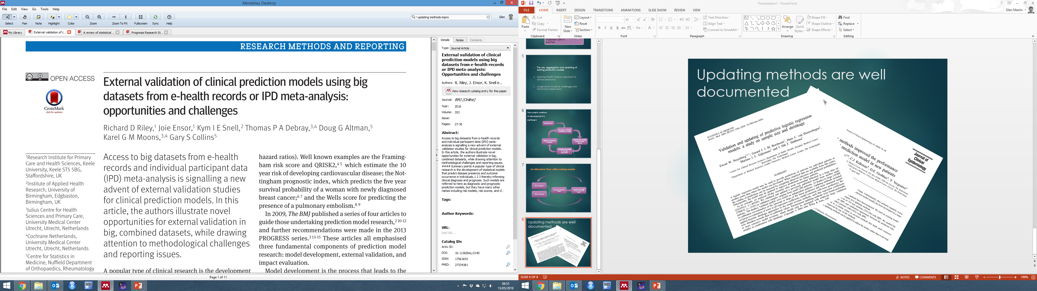
Methods to update a single existing CPMs are widely known

Slide 7
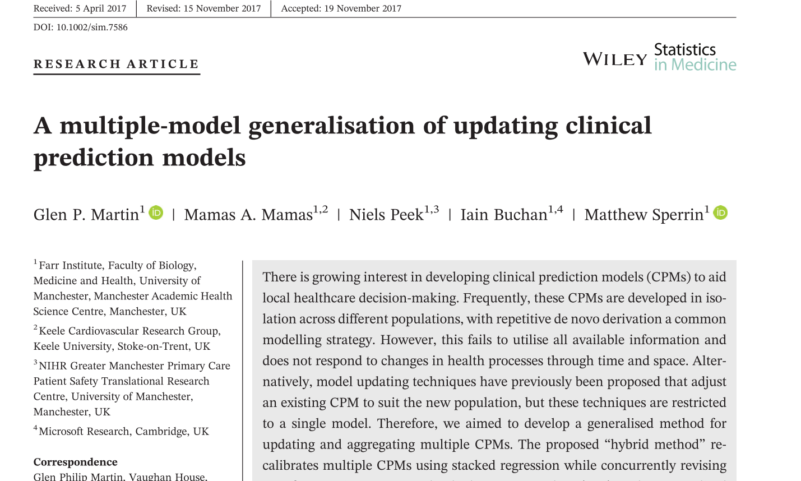
We proposed a ‘hybrid’ method that extends (individual) CPM updating methods to consider multiple models and prior knowledge

Slide 8
However, these methods still assume the data arrive in batches
Interpret
Feedback
Change
Assemble
Analyse

Slide 9
The use, aggregation and updating of existing prediction models
Learning Health Systems approach to clinical prediction
Longitudinal models & challenges with informative observation
Causal Prediction Modelling

Slide 10
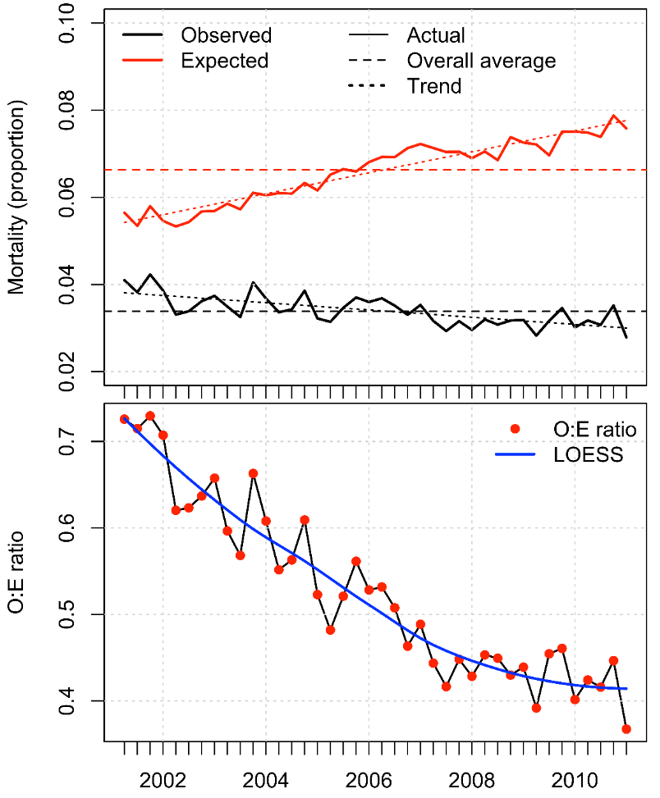
Calibration Drift
Calibration drift:
Typical of many published models
Academia rewards publishing papers on the same topic every 10y or so
The law now sees algorithms as medical devices
(EU Directive 2007/47)
From G. Hickey & B. Bridgewater

Slide 11
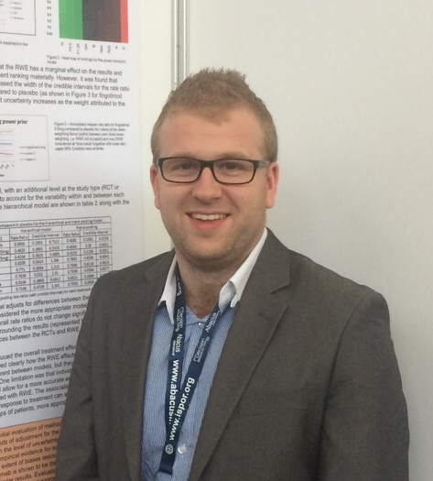
Opportunity: CPMs that “learn”
The Learning Health Systems (LHS) concept changes the way we look at knowledge, evidence and models
Models should be updated whenever new data becomes available
This leads to new notations of “model” and “model validity”
Dynamic prediction models
CPMs that update over time
Coefficients constantly varying and evolving over time
Uses CPMs that dynamically adjust for the changing relationships between the observed case-mix and the outcome

Slide 12
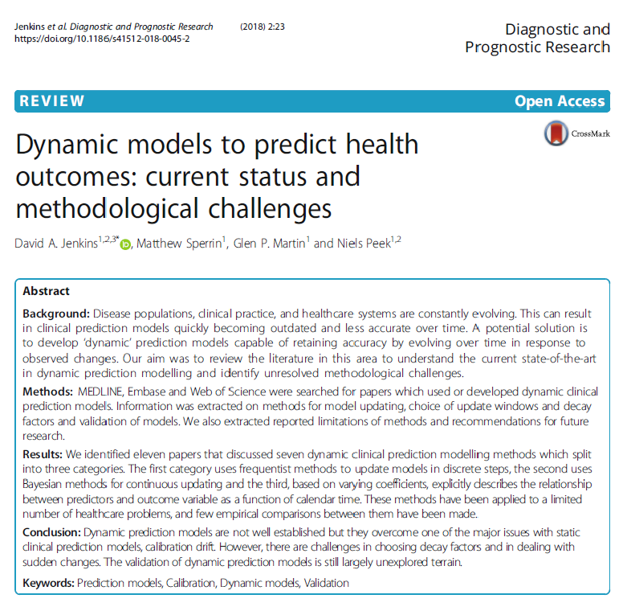
Dynamic Prediction Models
Three broad “types” of dynamic CPMs
Static Updating (as outlined above in the aggregation work)
Bayesian Dynamic Models
Varying Coefficient Models
Notes:
Briefly describe each metho

Slide 13
The use, aggregation and updating of existing prediction models
Learning Health Systems approach to clinical prediction
Longitudinal models & challenges with informative observation
Causal Prediction Modelling

Slide 14

Longitudinal Approaches to Clinical Prediction
Recent reviews provide evidence that the predictive accuracy can be improved by incorporating longitudinal information.
Less than 9% of prediction tools developed on electronic health record data acknowledge the time-varying nature of their predictor variables
No systematic review to identify available methods, despite many reviews

Slide 15
Systematic Review
Full-text assessed for eligibility (n = 247)
Records identified through database searching (n = 10 615)
Ovid Medline (2762), Ovid Embase (1985), Web of Science (5868)
Full-texts excluded (n = 12)
Reasons: Feasibility study (1), Latent disease state identification (2), Model updating (1), Non-binary outcome (6), unsupervised clustering (1).
Records after duplicates removed (n = 6 960)
Studies included in methodological review (n = 235)
Abstracts assessed for eligibility (n = 752)
Records title screened (n = 6 960)
Abstracts excluded (n = 505)
Reasons: population-level prediction, univariate CPM suggested, continuous/categorical response, method with no application, identification of predictor, no clinical application, baseline CPM developed, or model validation.
Records excluded (n = 6 208)

Slide 16
Three aims for incorporating longitudinal information into the development of a prediction model
1
2
3
To improve model specification and allow for updated risk predictions over time
To infer/predict a true value of a predictor at a pre-specified time.
To account for changes in a predictor within a historical time window.

Slide 17
Identified 7 Frameworks for Longitudinal CPMs
Time-dependent covariate modelling
Generalised Estimating Equations
Landmark Framework
Two-stage Framework
Joint-modelling
Trajectory classification
Machine Learning algorithms
Notes:
Restricted in time to talk through these – but essentially make the point that there are a lot of methods that could be used to develop longitudinal CPMs, but they very rarely are. This wide choice means that it should be possible to find a method to suit most practical applications – Lucy’s review will help such identification.

Slide 18
What does our method choice ultimately depend on?
Type and amount of information available at the time of prediction (as well as for model development).
How you want to make use of longitudinal information (methodological aims 1, 2 or 3).
What you already know about the repeated measurements and their association with the outcome of interest.
The number and type of variables you would like to model longitudinally.

Slide 19
Issues with Informative Observation
Time
The timing and frequency of observation in routine health data is informative
Notes:
Informative measurement – inverse of missing data?
If no (or too few) measurements in defined interval – exclude (selection bias) or treat as missing
Informative measurement a.k.a. observation process or visiting process.

Slide 20
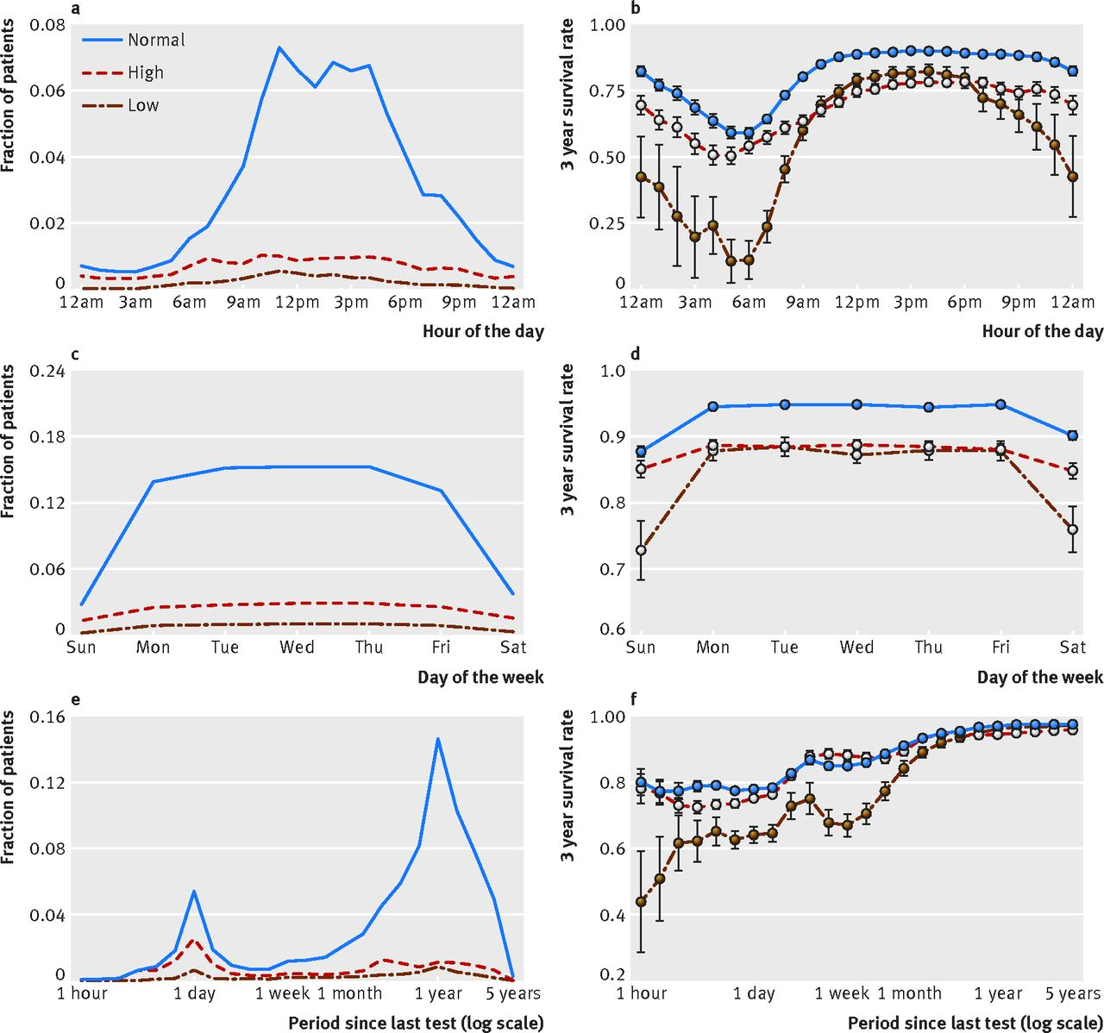
An illustration
Timing of observation (e.g. lab test) associated with mortality
Time between observations associated with mortality
Both more accurate predictors of mortality than value of test itself
Agniel, D., et al (2018). Biases in electronic health record data due to processes within the healthcare system: retrospective observational study. BMJ

Slide 21

How widely is this problem understood and accounted for?
Scoping review to identify methodology which incorporates the observation process into CPMs
Remove the bias associated with informative observation OR
Allow models to ‘learn’ from informative observation processes
Identify gaps/opportunities for methodological development
Identify methodology which has not yet been used in CPMs but could be

Slide 22
Indicative Results
Large body of existing literature/methodology for incorporating observation process into regression models
E.g. Joint modelling, inverse intensity weighting
Seen little application to CPMs thus far
Could easily be extended to CPMs

Slide 23
The use, aggregation and updating of existing prediction models
Learning Health Systems approach to clinical prediction
Longitudinal models & challenges with informative observation
Causal Prediction Modelling

Slide 24
Most CPMs cannot be interpreted causally
For example, a common use of CPMs is to say things like: “if you stop smoking, your risk of cardiovascular disease will be lowered by 6%”
Age 34
Smoker
14% risk of cardiovascular disease
Age 34
Stop smoking
8% risk of cardiovascular disease
However, in general most CPMs cannot be interpreted like this – it assumes a causal structure to the model.

Slide 25
Example: QRISK
QRISK is used to guide statin initiation in UK guidelines
It is derived in a “treatment-naïve” cohort by removing all patients who take statins at baseline
This means that patients who contribute to the 10-year risk calculation may commence statins during the 10-year follow-up, making the interpretation of a 10-year risk derived from such a model difficult
For example, a patient's predicted risk of lower than 10% may be driven by similar patients in the derivation cohort taking statins shortly after baseline

Slide 26
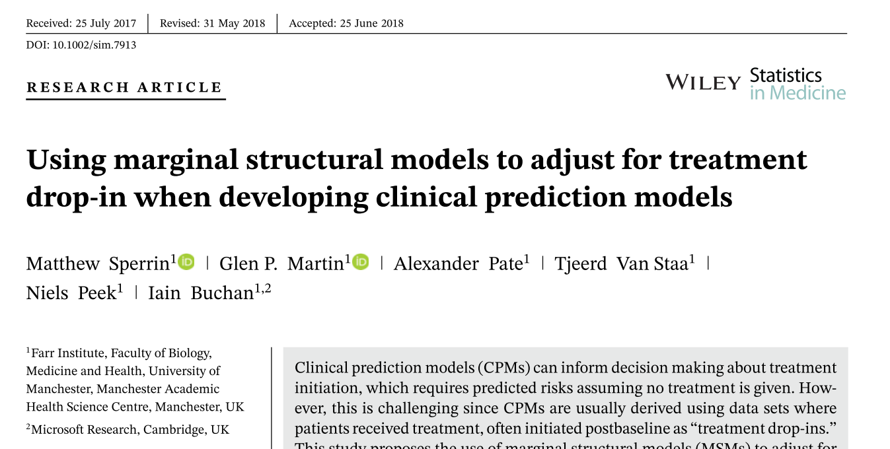
Methods for Developing Causal CPMs are emerging
Lots of research is still needed in this area

Slide 27
Take-home messages
Clinical prediction modelling is a very active area of research
Off-the-shelf approaches are not always appropriate to develop CPMs, and some advanced/novel techniques might be needed
Throughout today’s workshop we have explored overarching concepts to clinical prediction: we encourage deeper exploration of some of the concepts using the indicated (and other) literature

Slide 28

Thank you

